Slide 1
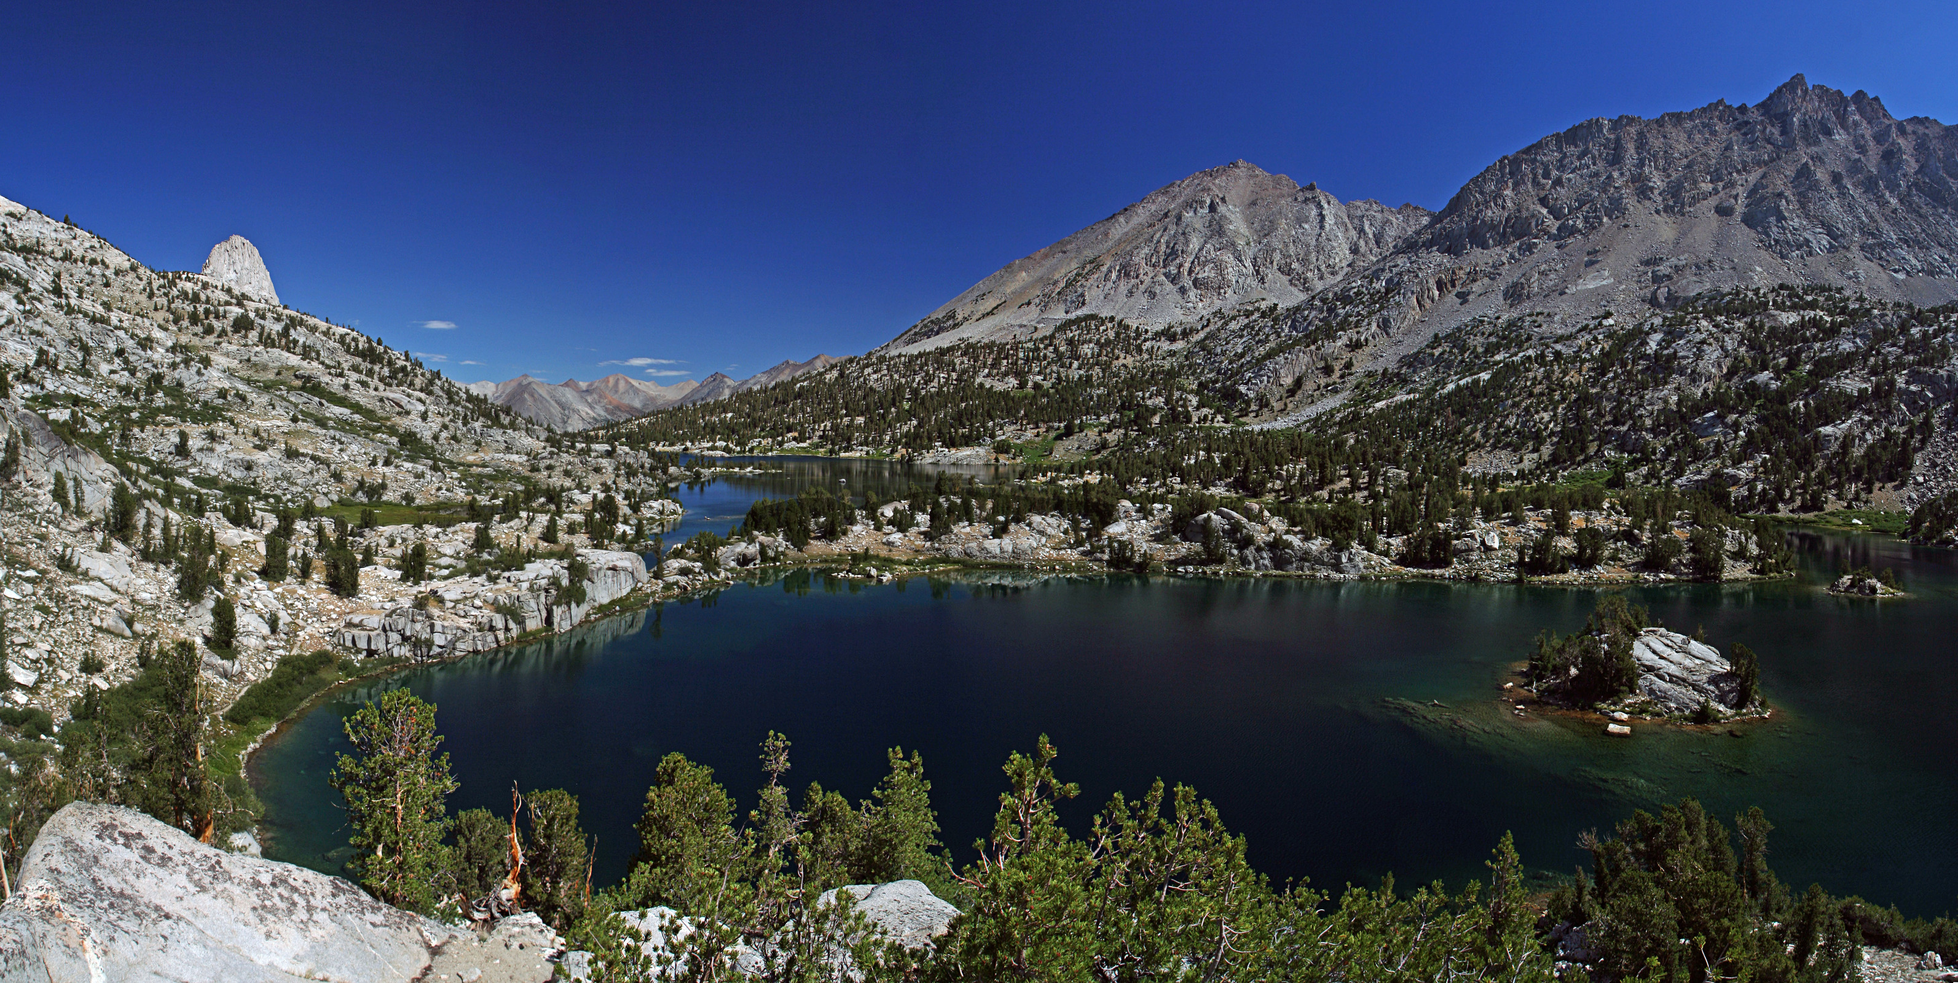
BPI VUStats Project
Final Presentation
Gaby Antonova and Will Mulhern
August 17, 2021
Notes:
Rae Lakes in SEQU

Slide 2
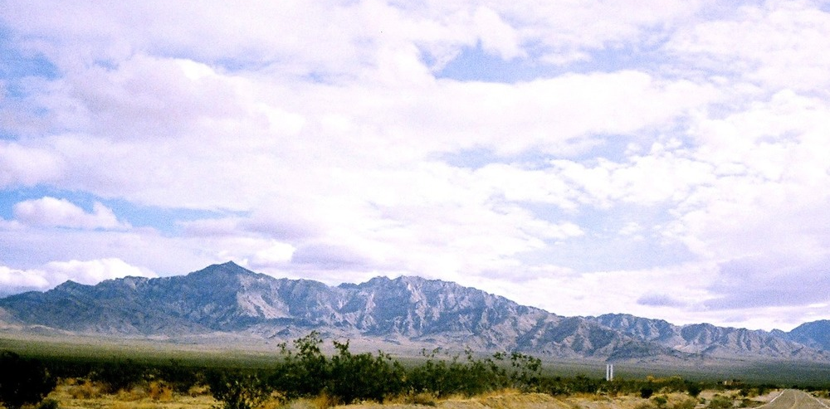
Agenda
Framing the problem
Methodology
Findings
Recommendations
Next steps
Discussion
Notes:
Mojave national preserve

Slide 3
Framing the problem

Slide 4
Framing the problem
SOW: There is a need to better understand the challenges faced by the customers who deliver data to the official reporting system for VUStats and about their knowledge/use of tools and resources available to them for assistance. As a complement to this, VUStats need to understand challenges faced by data users in accessing and consuming visitor use statistics. This project will reinforce ongoing work in the Social Science Program to develop new and enhance existing information delivery / communication tools in CY2021.
How might the NPS Social Science Program better deliver critical information to its customers about NPS Visitor Use Statistics to enhance customer experience and improve data quality and usability?
Notes:
We’ll start with the SOW, as we did in our midterm presentation which many of you saw. This is the language directly from the SOP, the bold part is probably the most important and outlines the key points and aim of our project. We’re trying to better understand how critical information can be delivered to

Slide 5
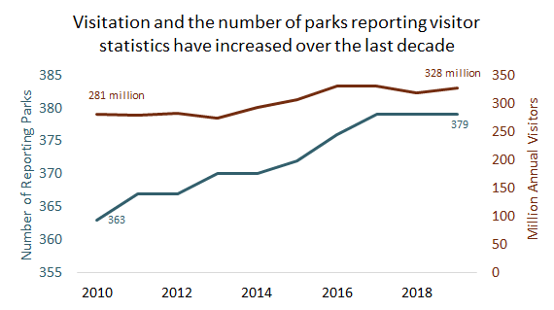
Framing the problem
IRMA Annual Summary Report for all parks, 2009-2019
Notes:
To give some context around the importance it’s helpful to see how the park service has grown over the last 10 years or so. You are all likely aware of this but this graph helps highlight the large increase in both visitation and number of parks. Both of these have major implication for visitor use stats. For one, the number you’re seeing on the right here is collected by the VUStats program, so this reinforces the importance of these stats. Also more visitors may indicate changing visitor use patterns .

Slide 6
Framing the problem
VUStats Team
Data utilization and data-driven decision making
Data quality
Data collection and operations
Notes:
In order to understand how the team can most effectively deliver customer service while supporting , we need to understand the types of work this team is engaging in across NPS.
Through our analysis we’ve come to understand the work of the VUStats team as fitting into the three broad categories: customer support and park-level troubleshooting; managing data quality by ensuring timely reporting and accurate, updated procedures; supporting higher level decision making and park-wide data utilization – this includes planning and support for larger initiatives.

Slide 7
Framing the problem
VUStats Team
Data utilization and data-driven decision making
Data quality
Data collection and operations
Using VUStats to deliver on the mission
Supporting data-driven decision making
Count procedures updates and studies
Staff training and engagement
Troubleshooting equipment
Answering user questions
Notes:
Within each of these categories we can break things down further to start thinking about the specific types of activities that the team is engaging in and where their time is being spent within these broader categories. Again, through our interviews and other analysis we have developed these 6 categories.

Slide 8
Framing the problem
VUStats Team
Data utilization and data-driven decision making
Data quality
Data collection and operations
Using VUStats to deliver on the mission
Supporting data-driven decision making
Count procedures updates and studies
Staff training and engagement
Troubleshooting equipment
Answering user questions
Notes:
Once we start thinking about our problem in this way we can start to assess the balance across these categories and determine what would be the most effective strategies for supporting the ideas listed in green.
And this is ultimately our task: we want to analyze what needs to be done to help the VUStats team effectively deliver on these goals.

Slide 9
Framing the problem
Using VUStats to deliver on the mission
Data collector
Supporting data-driven decision making
Count procedures updates and studies
Data user
Staff training and engagement
Troubleshooting equipment
Superintendents
Answering user questions
Notes:
To understand the current state of things we conducted qualitative analysis with stakeholders who we can group into three categories: Data collectors who work in parks; data users who span a variety of roles generally working at the WASO, regional, or program levels. And superintendents who have a unique relationship with VUStats because they deal with both data collection - managing park operations and adequate collection - and data use – using the VUStats data to inform park decision making and planning.
The lines here are showing how these different activities map to the stakeholder categories.
To give a sense of how we did this Gaby will talk a bit about our methodology.

Slide 10
METHODOLOGY

Slide 11
Participant Selection
Data collector
Stratified random sample of parks to identify data collectors
Data user
Selected based on contact with the VUStats team
Superintendents
Selected based on contact with the VUStats team
Additional superintendents interviewed based on referrals
8 park strata based on size and type
Data Collectors
Superintendents
Notes:
One external data user (SD Tourism)

Slide 12
Interviews
42 interviews completed
30-60 minutes long on average
78% response rate
7 out of 8 strata had 2+ participants
Data Users (13):
Kris Barnes
Rachel Collins
Charles Notzon
Erica Cole
Joanne Blacoe
Krista Sherwood
Donny Leadbetter
Ginger Irvine
Leslie Richardson
Christine Lipinsky
Spencer Wood
Bing Pan
Gregor Schuurman
Data Collectors (19 parks):
Susan Kowlok (WRBR)
Sarah Bone (MANZ)
Emilee Helton (AZRU)
Dave Meyers (AZRU)
Melissa Corsaut (JEFF)
Luke Howard (JEFF)
Aly Baltrus (NAMA)
Steve Hazelton (NAMA)
Jonathan Gagne (MIMA)
Theresa Moore (MORA)
Mary Sturdivant (SEQU)
Superintendents (10):
Eric Leonard (GUMO)
Steve Black (LIRI/RUCA)
Leslie Morlock (SARA)
Jeff West (CALO)
Scott Bentley (RIRA)
Jon Burpee (LEWI/VALR)
Paul Deprey (SAIR/SAMA)
Brenda Todd (LAKE)
Susanne Fleek-Green (LACL)
Brenda Pennington (STRI)
Keri Nelson (CANY)
Tyler Teuscher (KOVA)
Ryan Koepke (INDU)
Duane Michael (NERI)
Chris Olijnyk (FIIS)
Kristin Santos (FIIS)
Scott Berry (PIRO)
Eduardo Chaidez (JOMU)
MOJA
EVER
GOGA

Slide 13
Analysis
Code the interview data at a high-level, to develop summary statistics and identify insights.
Evaluate online resources like IRMA, the Common Learning Portal, and the SharePoint.
Interpret the themes and insights & consult with VUStats team during the development of recommendations.
1
2
3

Slide 14
Interview Analysis
Based on common answers to interview questions, we developed a high-level code book for summarizing interview data.
We coded 42 interviews in Excel, with notes to ensure that all relevant insights of interviews were captures.
We developed summary statistics quantifying key insights gained from coding.
Code Book
Interview coding
Summary statistics

Slide 15
Evaluating online resources
Evaluated the usability and functionality of IRMA.
Evaluated the intuitiveness and resources available on the SharePoint.
Evaluated the usability and resources available on the Common Learning Portal.
IRMA
SharePoint
CLP

Slide 16
FINDINGS
Notes:
That methodology resulted in a lot of findings – as part of our final deliverables we’ll be providing notes and full recordings of these interviews to the VUStats team, so here we’re going to focus on our primary findings and the ones that are most related to our recommendations. To start we’ll give some overall findings about the VUStats program, and then we’ll dive into the specific components of the problem we’re looking to solve.

Slide 17
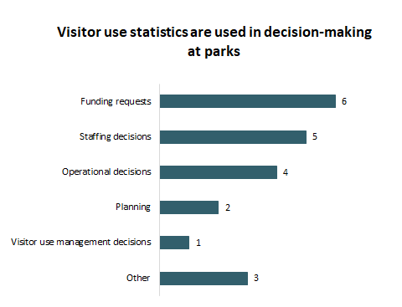
The VUStats Program is crucial to park and NPS operations
NPS-wide, VUStats data is used for:
Park planning and management decisions
Regional planning and management decisions
Allocation of GAOA funds
Economic impact estimates for local communities
Damage assessments
Asset management and valuation
“(Visitor use statistics) are so helpful in management decisions and looking at benefits to the park and how we understand what is happening to the park if you are not out there.”
Superintendent, SARA
Notes:
Make the title and text black

Slide 18
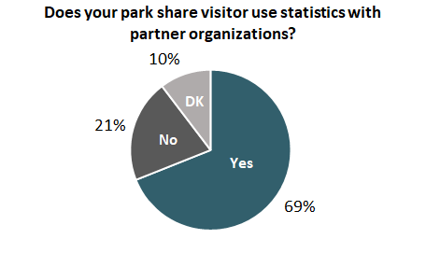
Most parks share their visitor statistics with partner organizations
Partners include:
Congressmembers
Local governments
State Tourism Departments
Local economic development group
Chambers of Commerce
Media outlets
Cooperating organizations
Park donors
“I’m using (VUStats) now trying to get a budget increase for the park. Showing that we do not have enough staff. Our Friends Group is using this data to lobby Congress. We’re using this data a lot.”
Superintendent, LIRI/RUCA

Slide 19
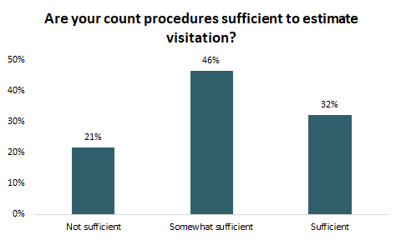
Count procedures often do not sufficiently capture visitation
“Almost every cultural park has fallen by one third to one half visitation compared to the 1970’s and 1980’s. We have the same demographic still visiting these historic sites, they’re not mom and dad with the kids, it’s now grandma and grandpa, who might have the kids, but for the most part not. I have a funny feeling the multiplier is probably down.”
Data collector, FOLA
“We’re definitely selling ourselves short on camping and even more so on backcountry camping. There is probably some trails that we are selling ourselves short on… Our systems are antiquated.”
Data collector, NERI
“We’re absolutely undercounting. We don’t know if we’re undercounting by 5%, 10%, or 20%”
Superintendent, LACL
Notes:
Parks that stated that count procedures were “somewhat sufficient” generally had issues with specific parts of their park.

Slide 20
Capacity of the VUStats team
~50% of VUStats time goes to park customer service requests.
The VUStats team is at capacity
Time
Backlog of projects
Flow of requests
New Projects
The Socioeconomic Monitoring Program will take additional VUStats capacity for the foreseeable future.
The VUStats team carried over more than 200 projects last year, like updates to count procedures and park audits.
The flow of all park requests goes directly into the VUStats team’s inboxes.
Notes:
50%-75% of time toward working with specific parks and data collectors, depending on the time of year. Claire
2/3 of time spent consulting with parks, and 1/3 spend checking data. Pam
First year I Last year I carried over close to 200 project – we are so far behind on doing things that extra time would give me more of a chance to do the things we already do. We are getting further and further behind every year.
250 projects behind250 projects behind at the end of the year.
These projects are things like updating count procedures, 2021 project list in planner. Audits, reviews, count procedure updates, prepping for SEM.

Slide 21
Customers feel supported by the VUStats team
“(VUStats team) is great, I wish more people could talk to them and listen to them.”
Regional interpretation planner
“Pam is always so accommodating and available. 100% of the time we have had things clarified and fixed to the degree that they can be (without a VU study).”
Superintendent, CALO
“I find that (the VUStats team) is very responsive in getting back to us, setting expectations around ‘we can help you, but we need XYZ’. I’m a superuser, I am coming at this with over a decade of engaging that office.”
Superintendent, GUMO
Notes:
Describe lack of awareness of resources.
Folks have asked for resources that are already available somewhere.

Slide 22
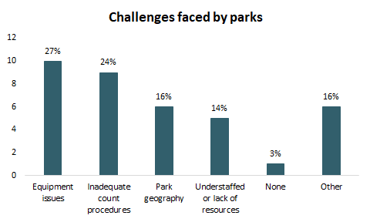
Common challenges related to visitor use data collections
Notes:
Others:

Slide 23
Framework
Data collection and operations
Can parks collect and report data easily and accurately?
Quality of data
Is the methodology accurate and is the equipment reliable?
Data utilization in decision-making
Is the data suitable for end users and can it be used for decision-making?

Slide 24
Data collection and operations
Notes:
This ties back to the initial question in the SOW and the three main categories in our framework. We want to understand how data is being collected on the ground level and how well is the collection of data being operationalized at the park-level.

Slide 25
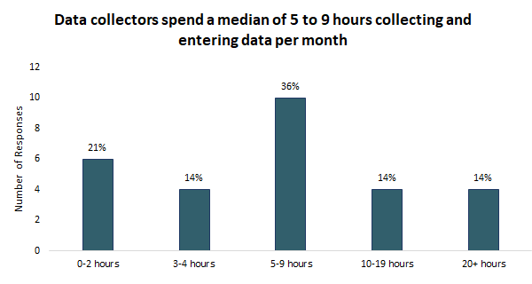
Time spent on visitor use data collection and entry
Data entry and collection feels like a significant burden, given the other staff responsibilities.
Parks are spending different amounts of time collecting and entering data. This is due to:
Park type,
Park size, and
Complexity of count procedures.

Slide 26
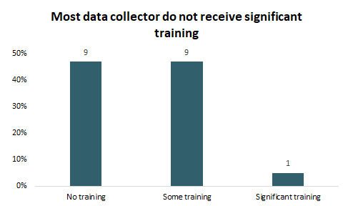
There is a lack of formalized training for data collectors
“I just inherited the data input. The person who had done it before me took 5 minutes to go over what he had been doing.”
Data collector, JEFF
“It’s all been kind of on-the-job training. I had a good working knowledge of statistics from my previous roles … this has helped me understand the broader picture.”
Data collector, NERI

Slide 27
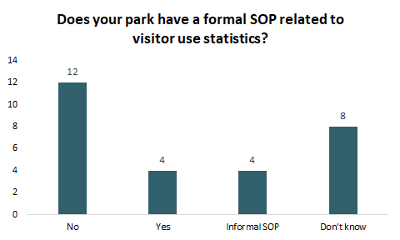
Most parks do not have formal VUStats SOPs
63% of parks do not have formal SOPs and half of those that report having some form of SOP have only informal documents.
“It pretty much just lives in my head, at one point we did have (an SOP), but it has not been updated for some time … People move in and out of the parks too fast to pass that information on orally. So, I think (we need) a hard copy document.”
Data collector, FOLA

Slide 28
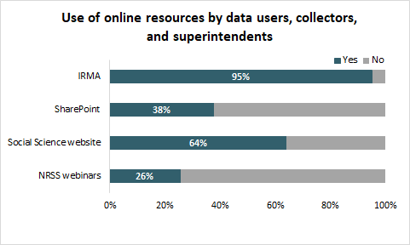
Available online resources are underutilized
“Didn’t even know there was (a SharePoint site), that is really good information.”
Data collector, MORA
“We have so many of those things (SharePoint sites). I think I had 414 that were bookmarked. I’ll pick up the phone and call before I (visit the SharePoint). They may direct me there, that’s great. I’m gleeful to do that. But a 30-second phone call will take the place of trying to find something on a SharePoint site.”
Superintendent, CALO
Notes:
Describe lack of awareness of resources.
Folks have asked for resources that are already available somewhere.

Slide 29
Data quality
Notes:
Our second category is data quality. Here, it’s important to note that we are more specifically looking at the accuracy of methodology and the social science principles that underlie VUStats data. Operations and data collection will of course impact quality, but since we’ve already covered the challenges there, this second category is more focused on the methodology

Slide 30
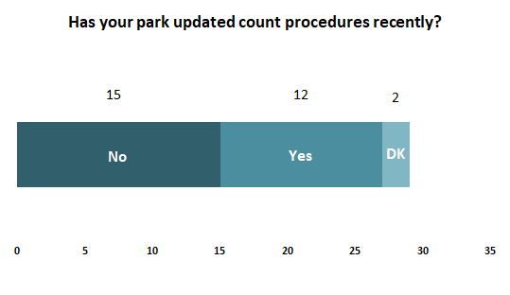
Frequency of count procedures updates
“The park service needs to figure out some kind of schedule so that the stats are actually valid.”
Data collector, FOLA
“I think I have count procedures, but they’re really old. I have thoughts on where counters are placed and how we can improve their placement. The concern is that if we change it now it just ‘whacks out’ 40 years of historical data that was collected differently.”
Data collector, WRBR

Slide 31
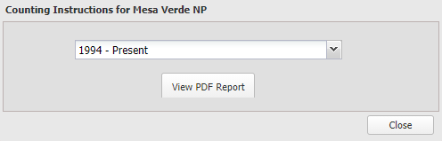
Main barriers to count procedure updates
VUStats team capacity
Parks not knowing how to initiate updates
The VUStats team reported having over 200 projects on their backlog. This number grows every year.
“Ideally, these would be updated every 5-10 years, I’d say about every 7, this would be sensible based on my experience. At one time, I figured we’d need about 6 people to do this. This may grow as we add parks” (Pam Ziesler)
Many parks expressed a desire to update count procedures but were unsure of how to get the process initiated or how to identify funding.
“Explaining to parks how they can get new visitor use studies funded, beyond just that there are visitor use studies. Like a prime PMIS project, having that type of portfolio of current and relevant guidance would really, really help.” Superintendent, LEWI

Slide 32
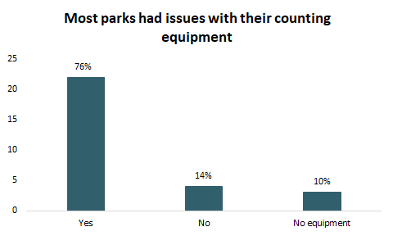
Equipment and Technology
“The main counters are fine, but the little ‘end of the road’ counters are gone, we don’t have any way to gather the data. I think it’s related to not having anyone available to do it, I don’t necessarily think it’s budget related. But I’m not in a position to go install a traffic counter.”
Data collector, SEQU
“We got some trail counters and I’d like to use those, but I don’t know what I should be subtracting and that kind of thing.”
Data collector, PIRO
Notes:
Types of equipment issues

Slide 33
Common equipment challenges
Vandalism / theft
Purchasing
Tracking / maintenance
Weather
“We need to have someone in place who can say ‘here are the 45 pieces of equipment that are most needed at parks’ and have them available.”
Superintendent, SAIR
“Every year, with end of year money, we’ve been buying more (TrafX traffic counters)”
Superintendent, LIRI/RUCA
“We had an issue where we buried one of them and then the person that buried it couldn’t find it.”
Data collector, WRBR
“It’s so remote. Getting the data to report, getting the equipment to be functional and figuring out where to put it are our big challenges there.”
Superintendent, LAKE
“(The counters) don’t like forest fires!”
Superintendent, LIRI/RUCA
“In a marine environment, our counters oxidize really easily. We have to resort to 3- or 5-year averages when that happens”
Data collector, GOGA
“We have lots of issues with vandalism of counters. The automated counters have electronics, and we need to take extra precautions in housing or hiding counters to prevent vandalism. Or we just end up repairing and replacing them more often. We’re an urban park and deal with urban problems.”
Data collector, GOGA

Slide 34
Data utilization and data-driven decision making
Notes:
The final category is focused on end users and decision-makers within NPS. Here, we want to understand if the data can be understood and effectively utilized to drive important decision-making within parks. This is the final category that we’ve identified for the VUStats team.

Slide 35
Usability of data
Feedback from data users
Data quality is variable and unclear / lack of understanding of underlying methodology.
IRMA is easy to navigate for experienced users but is not intuitive.
“If you see a visitation trend, in one way or another … something this system doesn’t have is context. Were the counters broken? Were there lapses in the personnel?”
Tourism program manager
“I’d like to see variability built in…being an end user, I don’t know anything that’s going on in any of the parks. I don’t know if the variability has anything to do with how they are collecting data or changes in the process.”
Internal Data User
“Bad data is worse than no data”
NPS Economist
“I (find it easy to navigate) because I know what I’m looking for. But I don’t think other people do. The menu page is inconsistent. I don’t think it’s intuitive for a lot of people unless they use it a lot”
Regional interpretation planner

Slide 36
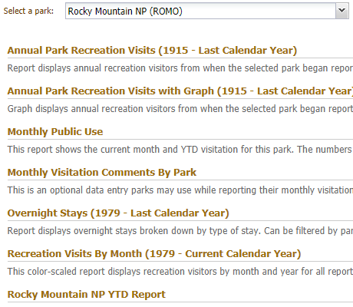
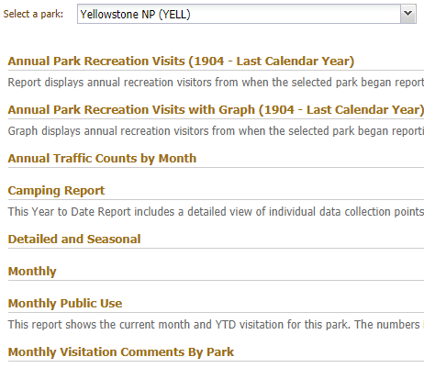
IRMA
Rocky
Yellowstone

Slide 37
Superintendent data utilization
Inconsistent utilization of VUStats at the park-level
The lack of formal VUStats training for superintendents
Some superintendents use VUStats to make park management decisions:
“Visitor use is critical to where we put positions, where we fund positions. Resource management, maintenance positions. If we have terrible stats, we don’t know how busy we are.”
Superintendent
Others are less confident:
“Because I think we’re getting such limited numbers as to what’s actually happening, sadly we are making more decisions based upon inference … (planning decisions) are not really based on numbers, it’s based on (what we’re seeing in) our field. We’d sure love to base it on numbers.”
Superintendent, LEWI
“As a superintendent, getting trained up on what visitor use stats you have and how it can help you manage the resources of the park. It’s not something, as a new superintendent, you really get trained on. There needs to be a lot more training at that superintendent level.”
Superintendent, LACL
“The opportunity here is that VUStats is not being represented at the (superintendent) level. There is an opportunity to somehow change that. There is a critical need to put (VUStats) in front of superintendents.”
Superintendent, GUMO

Slide 38
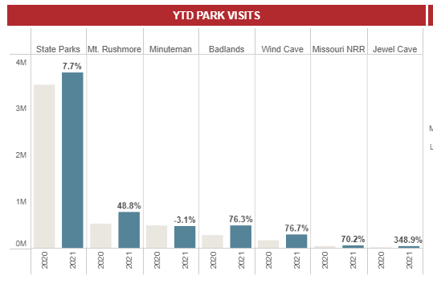
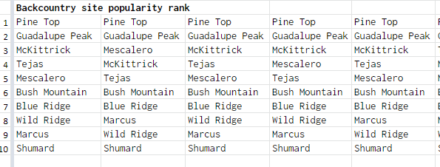
External data utilization
South Dakota Dept. of Tourism
Guadalupe Mountains Visitor

Slide 39
RECOMMENDATIONS

Slide 40
Recommendations
Data collection and operations
Quality of data
Data utilization in decision-making
Improve communication
Address equipment challenges in parks
Improve data usability for end users
Expand VUStats team capacity

Slide 41
Recommendations
Improve communication
Expand the capacity of the VUStats team
Improve data usability for end users
Address equipment challenges in parks

Slide 42
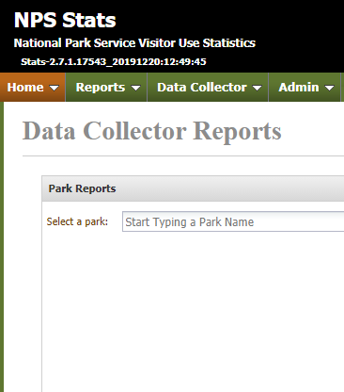
Centralize online resources – immediate
Goal:
Increasing awareness and use of already available online resources
Link all online resources in IRMA.
Increases access to online resources since 95% of customers access IRMA regularly.
Saves the VUStats team time spend on directing customers to various online resources.
Improves use of training material and understanding of data collection.
Source: IRMA

Slide 43
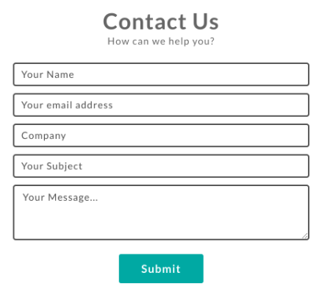
Create a ticketing system for contacting the VUStats team – immediate
Goal:
Offload the customer service burden on the VUStats team.
Ticketing system for contacting VUStats team.
Organizes requests so that multiple staff members can see them.
Saves time answering basic questions by making the landing screen a list of FAQs and links to resources.
Serves as a central place for making equipment requests.
Notes:
Create it in SharePoint, create an email where the responses are stored. Can it create a spreadsheet with responses too?

Slide 44
Streamline the VUStats SharePoint and Common Learning Portal
Goal:
Make online resources easier to utilize and navigate.
SharePoint Improvements:
Redesign the sections to improve intuitiveness.
Highlight training resources.
Add context about the importance of visitor use statistics to parks.
Improve the VUStats SharePoint and CLP.
More intuitive navigation for users needing assistance.
Less requests to the VUStats team for basic support and troubleshooting.
Improved knowledge sharing and collaboration across parks.
CLP Improvements:
Make CLP more visible
Invite new data collectors to the CLP
Create threads by park type to help parks connect about common issues
Notes:
Share some of our key ideas.

Slide 45
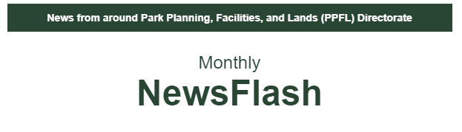
Establish consistent email communication with park staff
Goal:
Increasing awareness of VUStats team and program.
Communicating with staff:
Send out quarterly emails
Contribute a VUStats section on an existing newsletter
News from NROC
PPFL Newsflash
Communicate regularly with parks staff by email.
Increases the visibility of the VUStats program.
Ensures all park staff are aware of updates and new VUStats resources.
Source: PPFL Newsflash
Notes:
Most park staff said that they prefer to communicate over email.

Slide 46
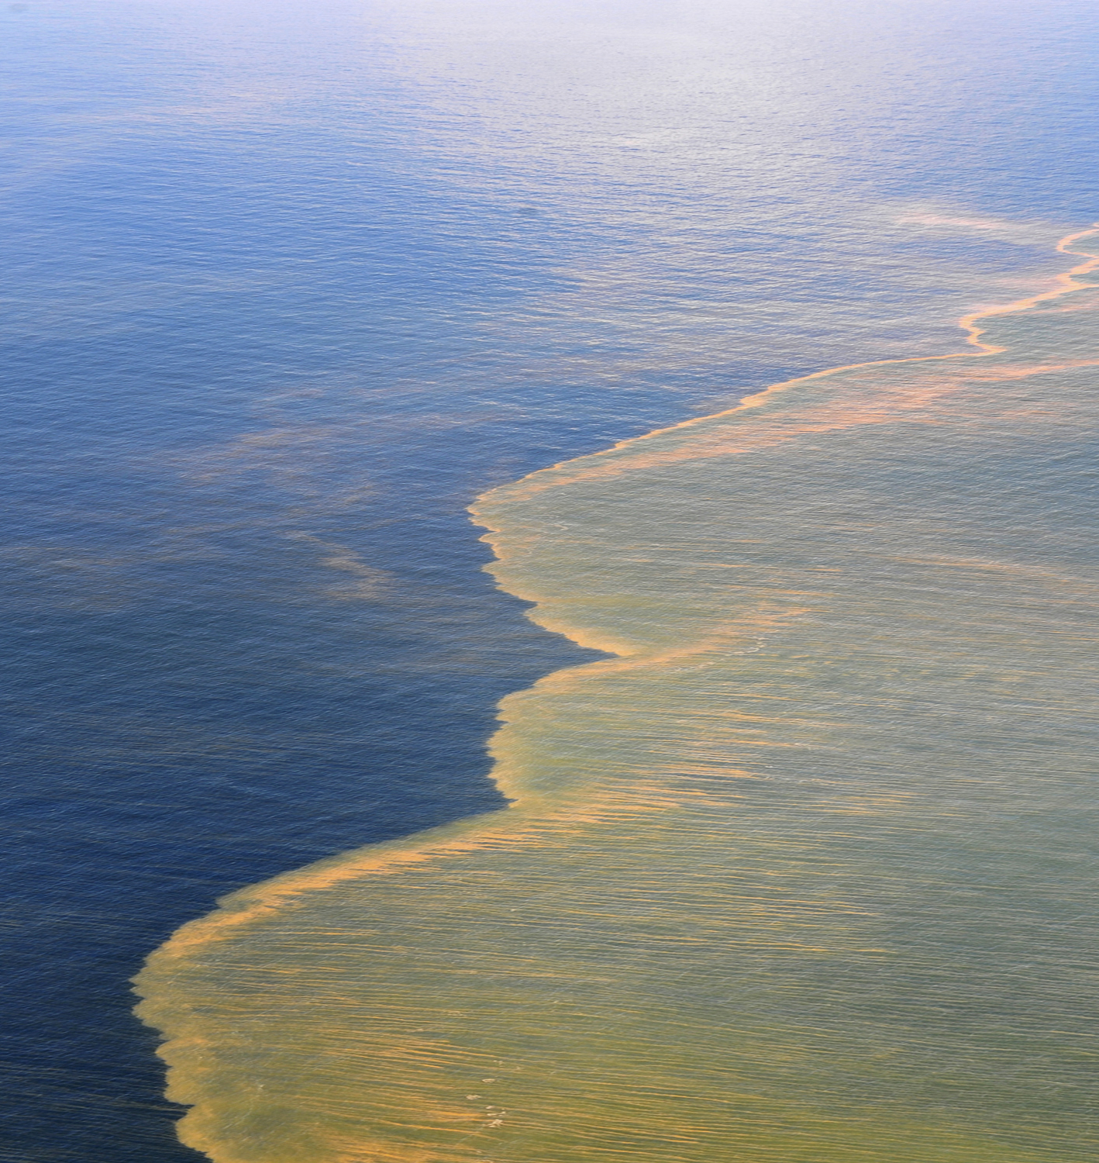
Develop case studies that exemplify the importance of visitor use statistics
Goal:
Improve data collector understanding of the importance and uses of visitor use statistics
Quote about wanting to understand the importance of stats
E.g.: Damage assessments
Develop case studies, including damage assessment cases and outcomes.
Convey importance of VUStats to park staff.
Increase the visibility of how VUStats are used.
Source: NPS
Deepwater Horizon Oil Spill

Slide 47


Create standardized data collector and superintendent training materials
Goal:
Improve park staff data collection capability and consistency and provide superintendents with a foundational understanding of VUStats.
Create and launch standardized training materials.
Improves data quality by ensuring data collectors understand collection methodology.
Saves VUStats team time and resources by reducing the number of basic questions they must address.
Improves superintendent understanding of how to effectively use VUStats for decision-making.
Notes:
Planning and Development – new superintendent academy – add VUStats to it (like 30 mins) – update next year when Pam and Claire have developed curriculum and when it’s time for an update to the curriculum

Slide 48
Recommendations
Improve communication
Expand the capacity of the VUStats team
Improve data usability for end users
Address equipment challenges in parks

Slide 49
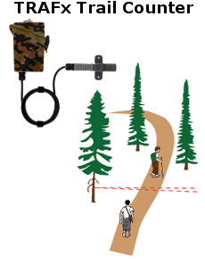
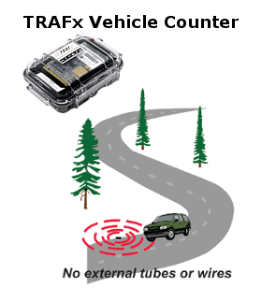


Distribute documentation for best equipment brands and models - immediate
Goal:
Standardize equipment purchasing and make recommendation based on specific park needs.
Documentation for best equipment on SharePoint
Cuts costs incurred from trial-and-error approach to selecting equipment
Saves park staff time researching equipment individually
Reduces training time for staff that is frequently on detail
Share documentation for best equipment on SharePoint.
Cuts costs incurred from trial-and-error approach to selecting equipment.
Saves park staff time researching equipment individually.
Reduces training time for staff that is frequently on detail.
Source: TRAFx website, Eco Counter website, Diamond Traffic website
Notes:
Pam already has some documentation that she sends out when staff asks
Hand and door counters may not need to be on this list
The criteria for best equipment would be usability, durability, discreetness, and cost.

Slide 50



Provide recommendations to park for avoiding equipment vandalism
Goal:
Reduce vandalisms and equipment theft.
Property of
Federal Government
Equipment under surveillance.
GPS monitored.
Evaluate and share strategies for avoiding equipment vandalism.
Cuts costs incurred from replacing equipment.
Saves park staff time replacing and repairing equipment.
Property of NPS.
Used for park management.
Please do not touch.
If you would like to know more, please visit nps.gov.
Notes:
Explain the study

Slide 51
Provide parks with information about securing funding for equipment
Goal:
Ensure parks secure the necessary equipment to capture visitation.
Options for equipment funding:
PMIS
GOGA has a 5-year request.
Requests to the VUStats team
Using the ticketing system
Allocating park budget for equipment purchases
Provide a resource outlining options for securing equipment funding.
Ensures parks have functioning equipment for capturing accurate visitation.
Saves park staff time in individually researching equipment.

Slide 52
Create an organization-wide method for tracking count equipment
Goal:
Understand which parks have equipment issues and allow parks to keep track of equipment.
Options for tracking equipment:
Create a new field in IRMA
Equipment type
Date last checked
Is it functioning?
Utilize FBMS for tracking equipment as assets.
Already has an asset category for traffic equipment
Create a way to track counting equipment.
Creates visibility around which parks are checking their equipment.
Creates transparency around which parks are missing equipment or have broken counters.
Allows parks to track and maintain expensive equipment more efficiently.
Notes:
Equipment is expensive – upwards of $500

Slide 53
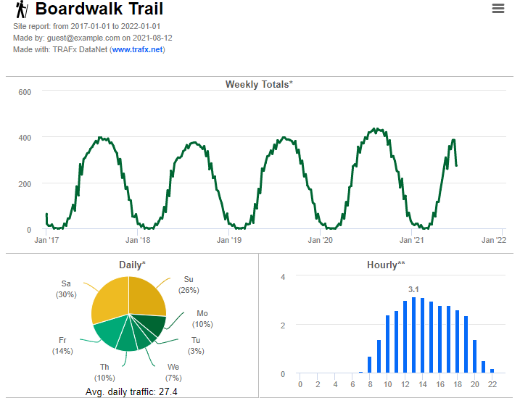
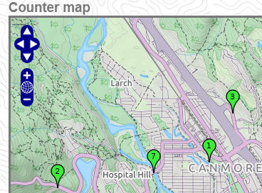
Establish a relationship with counting equipment providers
Establish a relationship with popular counting equipment providers.
Reduce equipment cost by purchasing equipment in bulk.
Reduce park staff time spent on individual equipment purchases.
Allow for more technical assistance from equipment providers.
Source:
TRAFx Datanet Demo
Notes:
Parks are already using TRAFx online resources and really like them

Slide 54
Recommendations
Improve communication
Expand the capacity of the VUStats team
Improve data usability for end users
Address equipment challenges in parks

Slide 55
Implement a system for indicating data quality to internal users - immediate
Goal:
Create transparency around visitor use data quality.
Implement a data quality indicator system.
Allows data users to understand more context.
Prioritize areas for improvement for individual parks VUStats processes.
Create groupings of parks based on similar characteristics.
Score
0-5
Time since last count procedure update
Reliance on estimates vs hard counts
Difficulty of data collection based on park geography
VUStats team confidence in the data

Slide 56
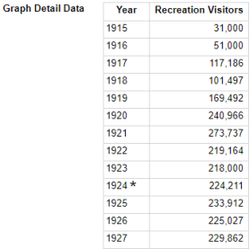
Flag changes in count procedures
Create a system for flagging changes in count procedures.
Creates more transparency and context for fluctuations in visitation.
Create more awareness around outdated count procedures.

Slide 57
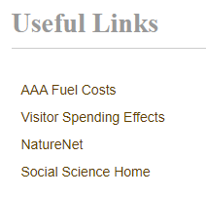
Improving navigability of IRMA
Goal:
Make IRMA easier to use for data collectors and users.
Improve organization and navigability of IRMA.
Provide links to training and background documents related to VUStats.
Standardize report lists for parks and make descriptions easier to read.
Call out “commonly used reports” to reduce time spent looking for specific reports.
Source: IRMA

Slide 58
Recommendations
Improve communication and knowledge sharing
Expand the capacity of the VUStats team
Improve data usability for end users
Address equipment challenges in parks

Slide 59
Expand the VUStats team capacity
Option
VUStats team capacity
Accountability and engagement
Cost
Create a VUStats task force with a representative from every region.
Slight increase
Moderate
Low

Slide 60
Expand the VUStats team capacity
Option
VUStats team capacity
Accountability and engagement
Cost
Create a VUStats task force with a representative from every region.
Slight increase
Moderate
Low
Hire a new administrative staff member on the SSP.
Increase
Low
Moderate

Slide 61
Expand the VUStats team capacity
Option
VUStats team capacity
Accountability and engagement
Cost
Create a VUStats task force with a representative from every region.
Slight increase
Moderate
Low
Hire a new administrative staff member on the SSP
Increase
Low
Moderate
A new staff member in each regional office focused on supporting VUStats and the SSP
Significant increase
High
High

Slide 62
Expand the VUStats team capacity
Option
VUStats team capacity
Accountability and engagement
Cost
Create a VUStats task force with a representative from every region.
Slight increase
Moderate
Low
Hire a new administrative staff member on the SSP.
Increase
Low
Moderate
A new staff member in each regional office focused on supporting VUStats and the SPP.
Significant increase
High
High

Slide 63
Next steps
Centralize online resources in IRMA
VUStats team
Short-term
Indicating data quality to internal users in IRMA
VUStats team with contractor help
Short-term
Distribute documentation for best equipment brands and models
VUStats team
Short-term
Creating a ticketing system or contact form
VUStats team
Medium-term
Create a VUStats Task Force
Leadership and VUStats team
Medium-term

Slide 64
Final deliverables
Presentation and report
High-level business case memo
Recommendations for IRMA and SharePoint
Raw data: Interview recordings, notes, and codebook

Slide 65
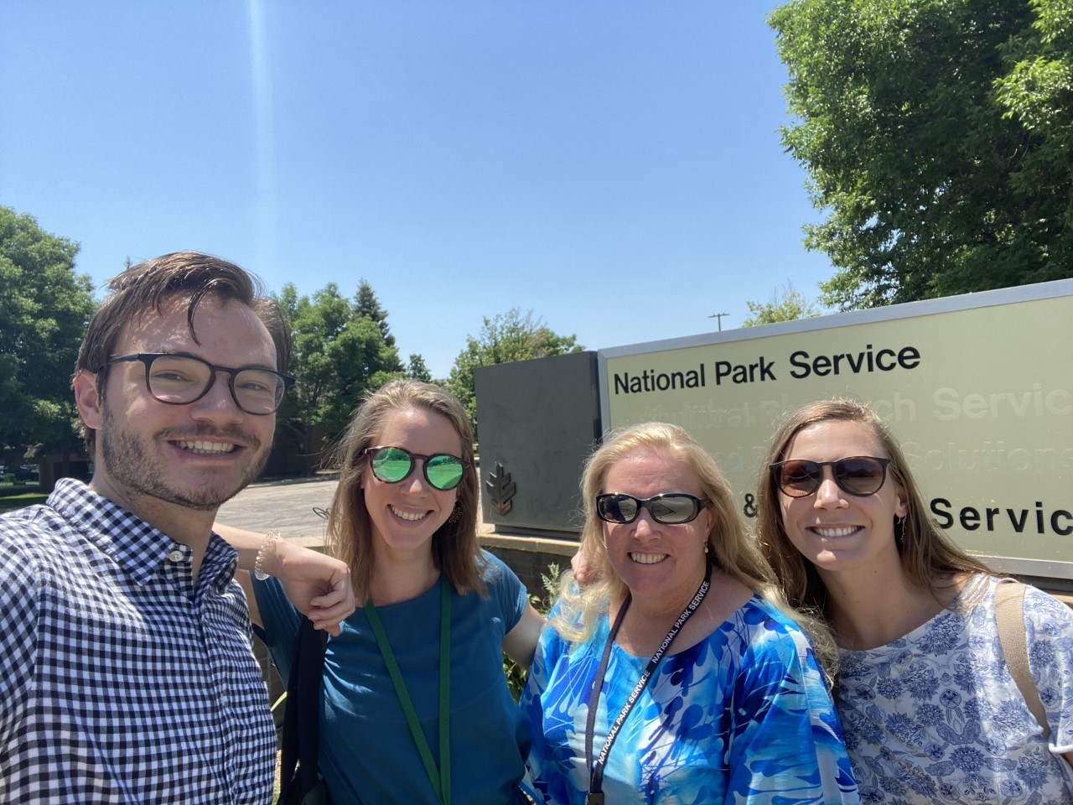
Acknowledgements
Special thanks to:
Pam Ziesler
Claire Spalding
Kris Barnes and the BMG
John McGreevy for qualitative research advice
The entire Social Sciences Program
All interview participants
For your help and support!

Slide 66
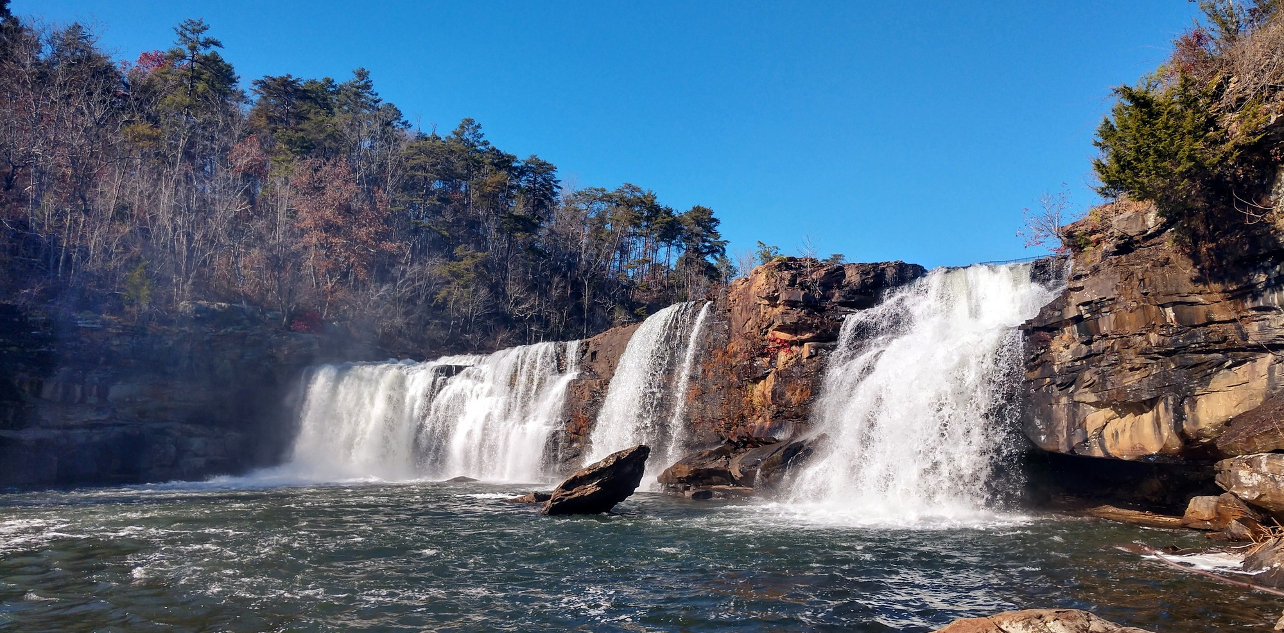
Discussion
Notes:
LIRI National Preserve

